Slide 1

Business Strategy for Wada Pav Shop

Slide 2
Define - Project Charter
Project Leader
Project Mentor
Project Sponsor
Process Owner
Dipankar Middya
Mr. Bose
Bhukēlēlā
Top Mentor
Voice of Customer
Goal Statement
A man wants to open a Wada Pav Shop near Shivaji Nagar in Pune. He has got a location where there are other 4 more wada pav shops. He is not able to understand what will be the strategy to take over his clients.
a. What will be the price of each Wada Pav?
b. How will he differentiate from the other competitors?
c. How will you bring insights when he has no data of his shop?
d. Why will be the Customer comes to your shop? (What will be the positioning)
e. What Machine Learning Models you will used to take to solve this Problem Statement? Whether Data Science is really required or not?
Give detail insight of the business and suggest business strategies to the owner to set up a successful business.
Project Plan
Days
1
5
10
15
20
Define
Explore
Implement
Sustain
Problem Statement
Project Cost
A man wants to open a shop named ‘Bhukēlēlā’, however de does not have any data to support his business strategy. Also there are 4 other shops in that area.
Stage | Define | Explore | Improvement | Sustain
Cost | ₹ 10,000.00 | ₹ 20,000.00 | ₹ 10,000.00 | ₹ 10,000.00
Critical Customer Requirement
Customer wants insight for his start up business. Also looking for suggestion about the business strategy.

Slide 3
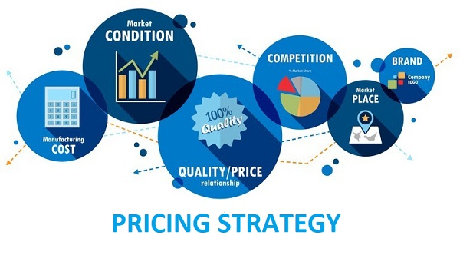
Explore-Pricing
Pricing is one of the most important components when it comes to creating marketing strategies. The price is one of the first things that a consumer notices about a product and is one of the deciding factors when it comes to their decision to buy it or not.
There are several factors which will determine the price of products. In this case the main factor is market competition. Hence we need to take Competitive Pricing Strategy.
There are three things that can be done in order to set the right price for your products:
1. If you’re planning to set the price above the price of your competitor, then you’d need to bring in new features and improvements in your product that would justify the increased price. 2. Pricing below your competitor’s price depends on your resources. If you can increase the volume without affecting the production cost to a great extent, then this might be a good strategy for you. However, there’s the risk of diminishing profit margin and you might not be able to recover your sunk cost and even face bankruptcy. So, it’s really important that you evaluate each step of your competitor while establishing the price for your product. 3. When you set a price equivalent to your competitor, then the differentiating factors cease to exist. The focus shifts to the product itself, and if you can offer more (and better) features at the same time, it’s a win-win for you, and your competitors will fall behind.

Slide 4
Explore-Pricing
What will be the price of each Wada Pav?
The price of Traditional Wada Pav would be the average of other four Wada Pav shop. If the new shop reduce the price the other shops might also reduce the price. So reduction of price will not going to help the new shop.
b. How will he differentiate from the other competitors?
The following can be differentiate the shop from other shop –
Other than traditional Wada Pav, shop can also introduce new types of Wada Pav after R&D. Example:- Wada Pav with Mayonnaise spread, Cheese spread.
Also the taste of the Wada Pav need to be differ from others by using some unique Masala in the Wada.
Seating Arrangement also need to be done.
Different types of Chatny other than Green & Red can also make the store different from other shops.

Slide 5
Potential Solution
How will you bring insights when he has no data of his shop?
We can conduct a survey before open the shop to collect data.
By analysing the collated data we can come to the conclusion how people will react on new types of Wada Pav.
Why will be the Customer comes to your shop? (What will be the positioning)
To taste new types of Wada Pav customers will go to the shop.
What Machine Learning Models you will used to take to solve this Problem Statement? Whether Data Science is really required or not?
We need to use Unsupervised Machine Learning Models to solve this issue.
Data Science is required to analyse the data and also create strategic business plan.

Slide 6
Thank You

